Slide 1
Flappy Bird Game
A Python Project Group members and their contribution: A.Samad Soomro 058 : Programming M.Saadat 013 : Picture sourcing Fahad Tanoli 020 : Presentation M.Saqlain 015 : Editing

Slide 2
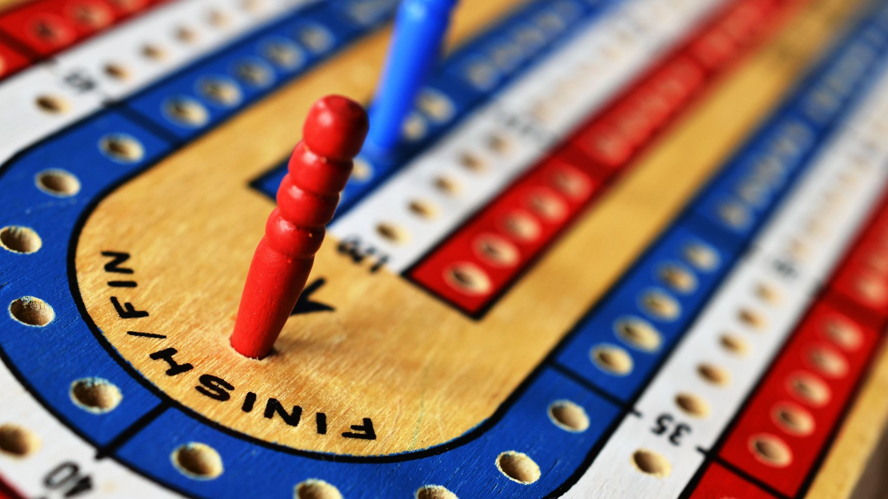
Introduction
Overview: Flappy Bird is a side-scrolling game where players tap the screen to keep a bird flying through gaps in pipes, aiming to achieve the highest score without crashing.

Slide 3
Game Mechanics
-How the Game Works: - The bird flaps and moves up when the spacebar is pressed - Gravity pulls the bird down constantly - Pipes appear from the right side of the screen at regular intervals - The game ends if the bird collides with a pipe or the ground

Slide 4
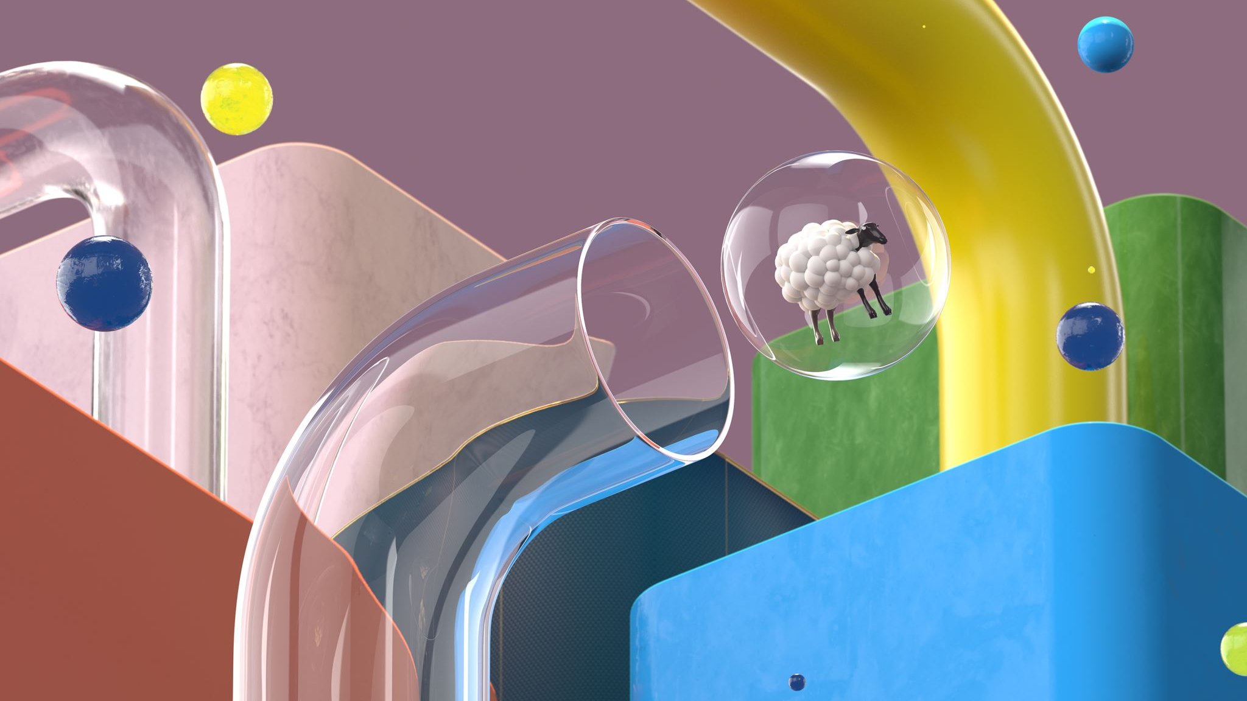
Key Features
- Animated bird - Scrolling ground and background - Randomly generated pipes - Collision detection

Slide 5
Libraries and Setup
- Libraries used:
- `pygame` for game development - `sys`, `time` for system and timing functions
- Initialisation:
- Setting up the display window - Loading images for the bird, pipes, background, and ground

Slide 6

Game Loop
- Continuously updates and renders the game - Handles events like quitting and key presses - Updates game elements and checks for collisions

Slide 7

Bird Class
- Responsible for bird’s image, position, and movement - Handles gravity, flapping, and animation - Code snippet: ```python class Bird(pg.sprite.Sprite): def __init__(self, scale_factor): super(Bird, self).__init__() self.img_list = [pg.transform.scale_by(pg.image.load(“assets/birdup.png”).convert_alpha(), scale_factor), pg.transform.scale_by(pg.image.load(“assets/birddown.png”).convert_alpha(), scale_factor)] self.image_index = 0 self.image = self.img_list[self.image_index] self.rect = self.image.get_rect(center=(100, 100)) self.y_velocity = 0 self.gravity = 10 self.flap_speed = 250 self.anim_counter = 0 self.update_on = False # More code … ```

Slide 8

Pipe Class
- Manages the pipes’ images and positions - Randomly generates pipe heights and positions - Moves pipes to the left and removes them when off-screen - Code snippet: ```python class Pipe: def __init__(self, scale_factor, move_speed): self.img_up = pg.transform.scale_by(pg.image.load(“assets/pipeup.png”).convert_alpha(), scale_factor) self.img_down = pg.transform.scale_by(pg.image.load(“assets/pipedown.png”).convert_alpha(), scale_factor) self.rect_up = self.img_up.get_rect() self.rect_down = self.img_down.get_rect() self.pipe_distance = 200 self.rect_up.y = randint(250, 520) self.rect_up.x = 600 self.rect_down.y = self.rect_up.y – self.pipe_distance – self.rect_up.height self.rect_down.x = 600 self.move_speed = move_speed # More code … ```

Slide 9
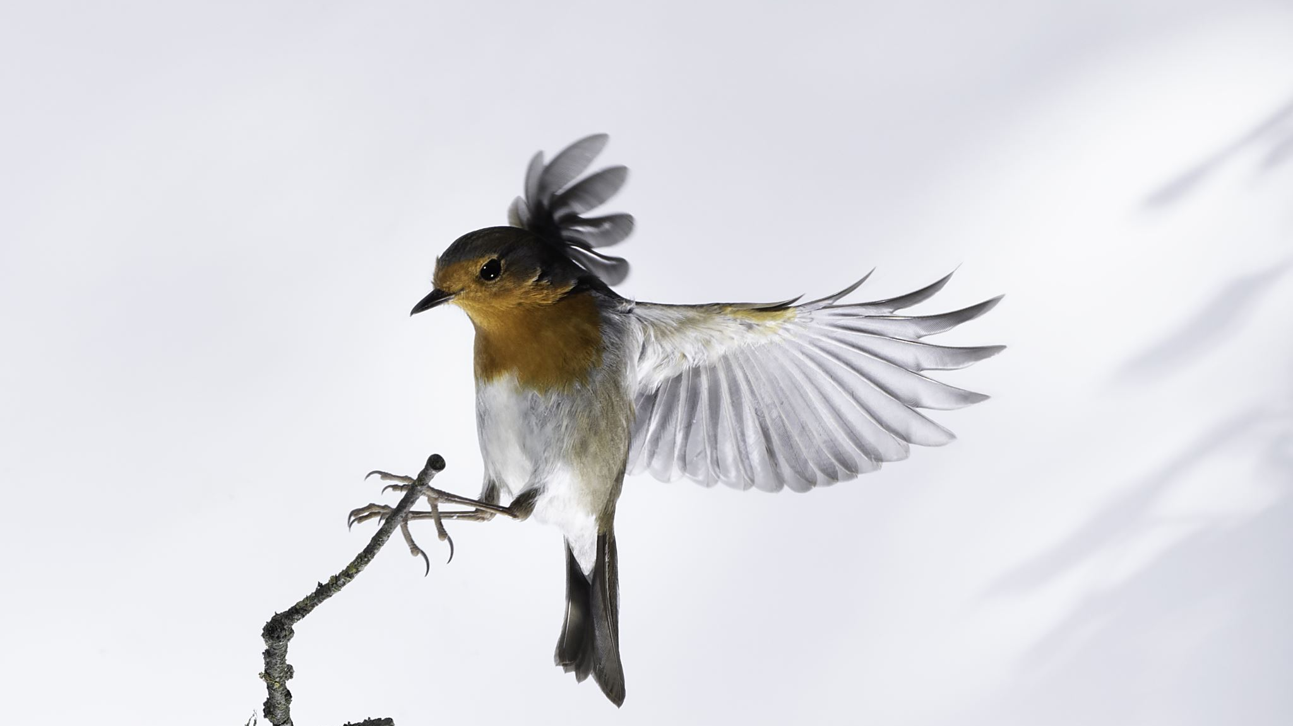
Collision Detection
- Checks if the bird collides with pipes or ground - Stops the game when a collision occurs - Code snippet: ```python def checkCollisions(self): if len(self.pipes): if self.bird.rect.bottom > 568: self.bird.update_on = False self.is_enter_pressed = False if (self.bird.rect.colliderect(self.pipes[0].rect_down) or self.bird.rect.colliderect(self.pipes[0].rect_up)): self.is_enter_pressed = False ```

Slide 10
Updating Elements
- Moves the ground and pipes - Updates the bird’s position and animation - Generates new pipes and removes old ones - Code snippet: ```python def updateEverything(self, dt): if self.is_enter_pressed: # Moving the ground self.ground1_rect.x -= int(self.move_speed * dt) self.ground2_rect.x -= int(self.move_speed * dt) if self.ground1_rect.right < 0: self.ground1_rect.x = self.ground2_rect.right if self.ground2_rect.right < 0: self.ground2_rect.x = self.ground1_rect.right # Generating and moving pipes if self.pipe_generate_counter > 70: self.pipes.append(Pipe(self.scale_factor, self.move_speed)) self.pipe_generate_counter = 0 self.pipe_generate_counter += 1 for pipe in self.pipes: pipe.update(dt) if len(self.pipes) != 0: if self.pipes[0].rect_up.right < 0: self.pipes.pop(0) # Moving the bird self.bird.update(dt) ```

Slide 11
Drawing Elements
- Renders the background, ground, bird, and pipes - Code snippet: ```python def drawEverything(self): self.win.blit(self.bg_img, (0, -300)) for pipe in self.pipes: pipe.drawPipe(self.win) self.win.blit(self.ground1_img, self.ground1_rect) self.win.blit(self.ground2_img, self.ground2_rect) self.win.blit(self.bird.image, self.bird.rect) ```

Slide 12
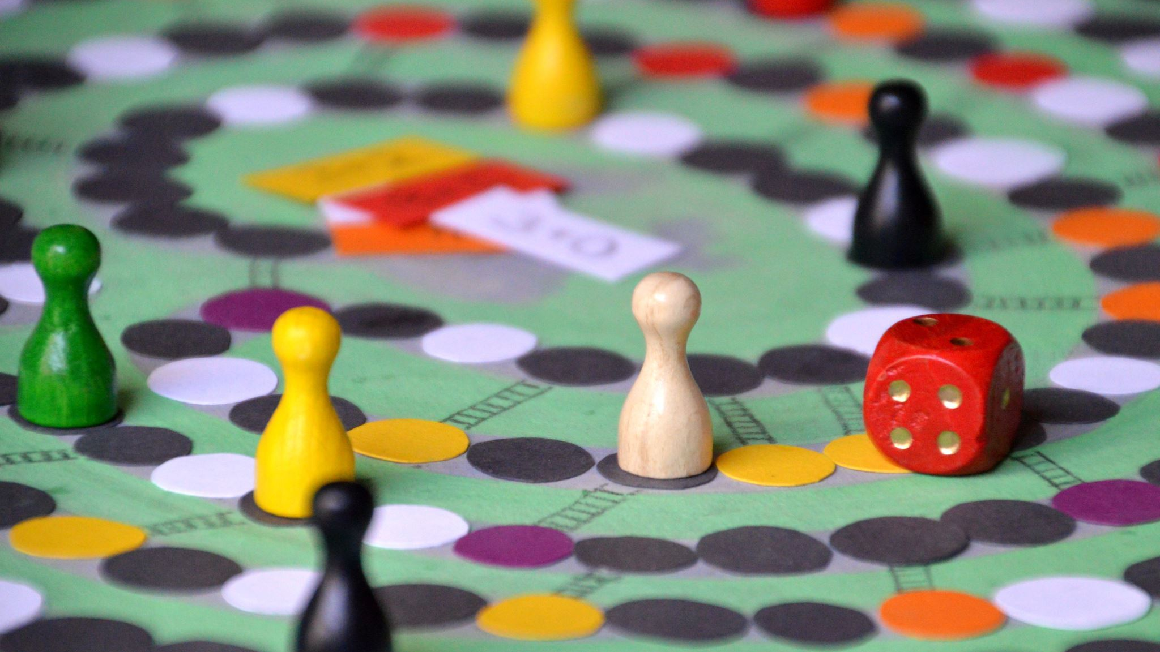
Conclusion
- Recap of the game’s functionality and main features - Explanation of how different classes and methods work together

Slide 13

Thankyou

